Slide 1


Slide 2


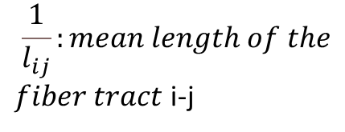
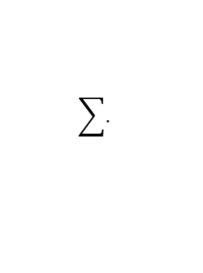
Construction
Expression z scores
Standard
Normal
Cumulative
Distribution
αi: SNCA
βi: GBA
Structural Connectivity
dwMRI → source: Human Connectome Project, 2017 S1200 release
Replacement ➔ Mouse connectivity Brain from ABA
Functional Connectivity Map
Gene expression → Allen Human Brain Atlas → Average among samples
Atrophy → Derived from T1-weighted MRI scans
Replacement ➔ Measurement of lesions ?
Synuclein Propagation → H. Regional endo levels of a-syn already existing in the brain may bias trajectory of misfolded a-syn → Solution:
$$\frac{1}{l_{ij}}:mean length of the$$
$fiber tract$ i-j
j
Edge i-j
βi
i
MTB
αi
$$\sum{.}$$
A-syn
$$1−\frac{1}{l_{ij}}$$
$$\frac{1}{l_{ij}}$$
K* density of the edge

Slide 3
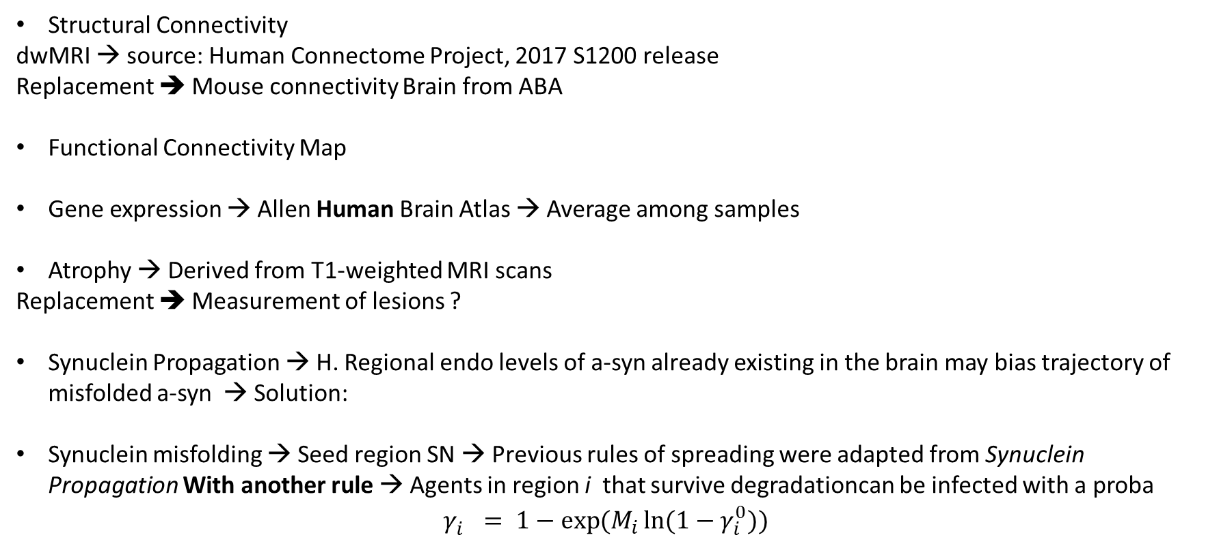
Construction
Structural Connectivity
dwMRI → source: Human Connectome Project, 2017 S1200 release
Replacement ➔ Mouse connectivity Brain from ABA
Functional Connectivity Map
Gene expression → Allen Human Brain Atlas → Average among samples
Atrophy → Derived from T1-weighted MRI scans
Replacement ➔ Measurement of lesions ?
Synuclein Propagation → H. Regional endo levels of a-syn already existing in the brain may bias trajectory of misfolded a-syn → Solution:
Synuclein misfolding → Seed region SN → Previous rules of spreading were adapted from Synuclein Propagation With another rule → Agents in region i that survive degradationcan be infected with a proba
$$γ_{i}^{}= 1−\exp{(M_{i}\ln{(1−γ_{i}^{0})})}$$

Slide 4
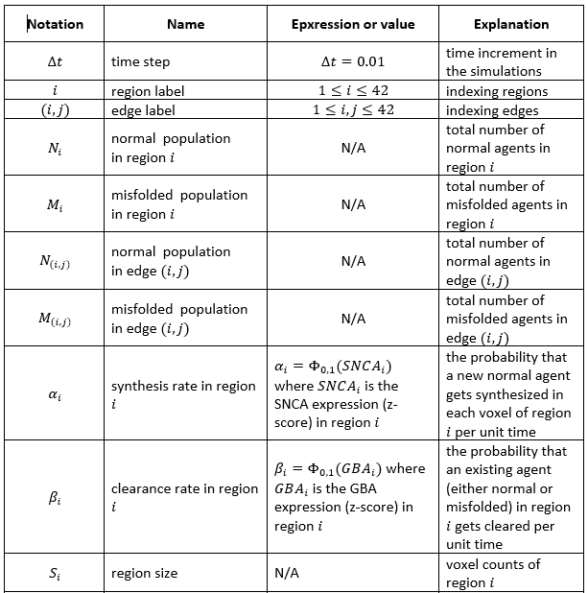
Parameters

Slide 5
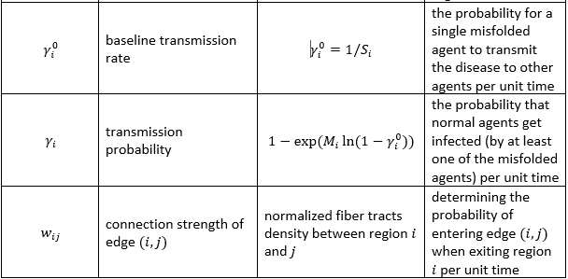
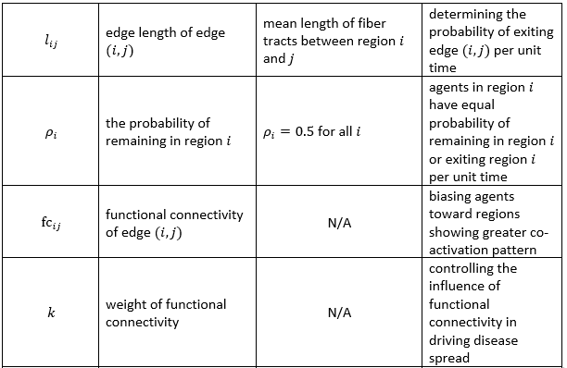
Parameters

Slide 6
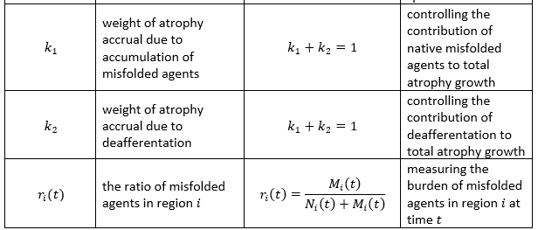
Parameters

Slide 7
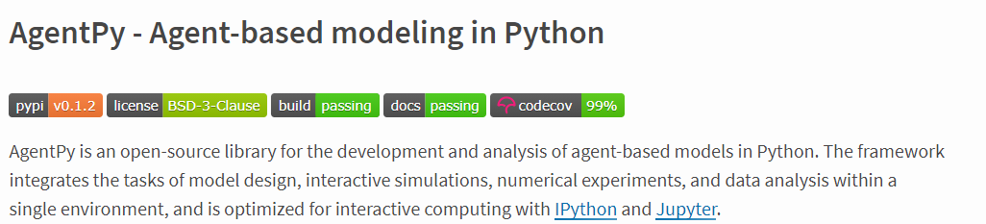

Slide 8
Construction
EXPERIMENT
MODEL
GRID NETWORK
SPACE
AGENT(s)

